Slide 1
Account model development
Pauliina Olsson-Hurt ı 11.3.2022

Slide 2
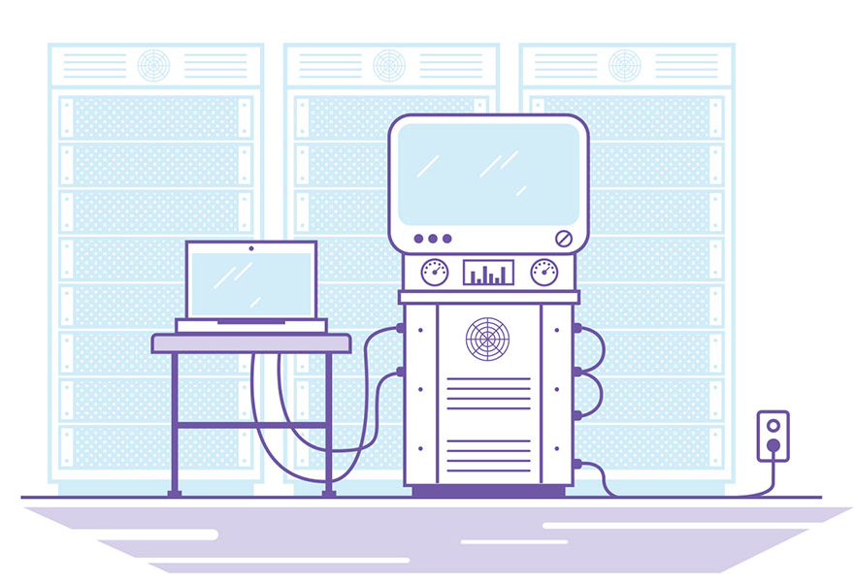
Background
eSett has received feedback from customers and banks to develop the account and collateral model
eSett wants to respond to the requests from the market and has started developing an alternative model
The new model will be taken into use with eSett’s settlement bank first in 2022. Other banks will follow if and when they have signed the new Settlement bank agreement

Slide 3
Current account management model
Pledged settlement account
-Invoicing and cash collateral account
On-demand guarantee
-Used for collateral deposit
Release account
-Funds from Pledged settlement accounts are released to this account
Between bank and BRP
MT101, payments
MT940, bank statements
Pledged account
agreement
On-demand guarantee
agreement
Standard Settlement Instructions (SSI)

Slide 4
New account management target model
Existing already
New component
Cash account
-Invoicing account
-Not pledged, BRP can release funds by itself
-Can’t be used for collateral deposit
-Can be part of cash pool or utilized credit limit
-Funds from Cash collateral account is released to this account
Cash collateral account
-Used for collateral deposit
On-demand guarantee
-Used for collateral deposit
Between bank and BRP
MT101, payments
MT940, bank statements
Agreement on Right of Disposal of Cash Account and Cash Collateral
Agreement on Right of Disposal of Cash Account and Cash Collateral
On-demand guarantee
agreement

Slide 5
Model features
In both models all accounts will be in approved settlement banks
BRPs have asked possibility to use cash pool/credit limits with settlement accounts, but it has not been possible so far
New model makes it possible to use cash pool and credit
When invoicing account is not pledged BRP gets credit invoice amounts to own account without separate release requests
Requires new agreements with BRP’s, eSett and the banks (pledged cash account agreement, settlement bank agreement)

