Slide 1
Information about
Nordic Imbalance Settlement to prospective Settlement Banks

Slide 2
Topics
About the Nordic Imbalance Settlement and eSett Oy
Invoicing, payments and collateral
Role of Settlement Banks
Agreements
Steps to become a Settlement Bank
Further information and contracts

Slide 3
About the Nordic Imbalance Settlement and eSett Oy
Imbalance settlement is a natural monopoly and a necessary function in a commercial electricity market
The Transmission System Operators (TSO) Fingrid, Statnett and Svenska kraftnät decided to implement a common imbalance settlement service for the electricity markets in Finland, Norway and Sweden. Now Denmark’s TSO Energinet is joining.
The three TSOs founded the joint service company eSett Oy to operate the Nordic Imbalance Settlement.
eSett Oy is incorporated in Finland and owned by Fingrid, Statnett, Svenska kraftnät and Energinet, each with a 25% share.
eSett has operated the imbalance settlement since May 2017, and the go-live for Denmark is Q1 2021.
The common Nordic Imbalance Settlement solution is supported by the governments and regulators in the Nordic countries and is regarded as an important step towards a fully functional common retail market.
Each national TSO is still ultimately responsible for the balancing operations in their country but eSett will manage the settlement on their behalf.

Slide 4
Imbalance Settlement is a necessary function in a commercial electricity market
Before delivery hour: | Delivery hour: | After delivery hour:
Physical trading | Balancing | Imbalance settlement
Operated by NEMOs* | Operated by TSO | Operated by eSett
Day-ahead
Intraday
Balancing market
Imbalance
settlement
Bilateral trades
Plan before delivery hour:
Production + Purchases = Consumption + Sales
Reality during delivery hour:
Production + Purchases ≠ Consumption + Sales
Imbalance settlement after delivery hour:
Production + Purchases ± Imbalance Power = Consumption + Sales
*Nominated electricity market operators

Slide 5
Imbalance Settlement is separate from the settlement of the physical trades
Before delivery hour: | Delivery hour: | After delivery hour:
Physical trading | Balancing | Imbalance settlement
Operated by NEMOs* | Operated by TSO | Operated by eSett
Day-ahead
Intraday
Balancing market
Imbalance
settlement
Bilateral trades
Settlement of physical trades:
Day-ahead and Intraday trades settled by NEMOs
Bilateral trades settled between the trading parties
Imbalance settlement:
Imbalance settlement is the settlement of differences between the physical trades and the actual production and consumption (=imbalances).
Imbalance settlement also includes the invoicing of certain fees as well as the settlement of reserves activated by the TSO in the balancing market.
Separate activities
*Nominated electricity market operators

Slide 6
Key aspects of the invocing model
Each Monday, eSett invoices the settlement result and fees from the delivery week that started three weeks ago
Weekly invoicing of imbalances, activated reserves and fees
  Positive invoice amount (BRP pays to eSett) → “Debit Notice”
  Negative invoice amount (eSett pays to BRP) → “Credit Notice”
BRP receives one invoice per country where it operates
BRPs can select to be invoiced either in default currency (EUR) or in local currency of the market balance area it is active (DKK, NOK or SEK)
Invoices are settled by eSett during the same week:
  Invoices are published on Monday
  Amount of Debit Notice direct debited by eSett on Wednesday
  Amount of Credit Notice paid out by eSett on Thursday
A holiday in the interval Monday - Thursday in any of the NBS countries
shifts the activities on and after the holiday one business day forward

Slide 7
The imbalance settlement results are invoiced and settled
~3 weeks after the delivery day
Calendar days |  | Week 1 |  |  |  |  |  |  | Week 2 |  |  |  |  |  |  | Week 3 |  |  |  |  |  |  | Week 4
 |  | Mon | Tue | Wed | Thu | Fri | Sat | Sun | Mon | Tue | Wed | Thu | Fri | Sat | Sun | Mon | Tue | Wed | Thu | Fri | Sat | Sun | Mon | Tue | Wed | Thu
Delivery days
 |  | 1 | 2 | 3 | 4 | 5 | 6 | 7 | 8 | 9 | 10 | 11 | 12 | 13 | 14 | 15 | 16 | 17 | 18 | 19 | 20 | 21 | 22 | 23 | 24 | 25
Mon | 1
Tue | 2
Wed | 3
Thu | 4
Fri | 5
Sat | 6
Sun | 7
Delivery day D0
Reporting of data D2 –D13
Settlement of week 1 final
Invoicing of week 1
Direct debiting of debit invoices
Payment of credit invoices

Slide 8
Role of Settlement Bank
Provision of cash accounts to the BRPs
Execution of ”Request for Transfer” instructions from eSett
Daily reporting of balances and transactions on the cash accounts to eSett

Slide 9
Provision of Cash Accounts to the BRPs
Forms of cash accounts:
  Pledged Cash Account
  Used for posting of cash collateral and for settlement of the BRP's invoices
  Governed by Pledged Cash Account Agreement
General conditions of Cash Accounts:
  Account has to be held in any of the participating countries
  Currency can be DKK, EUR, NOK or SEK depending on the settlement currency
  Bank and BRP can agree on terms, but these may not be in conflict with terms of Pledged / Non-Pledged Cash Account Agreement between Bank, BRP and eSett

Slide 10
Execution of “Request for Transfer” instructions from eSett
To collect the BRP’s payable amounts to eSett, eSett instructs the Settlement Bank to debit the BRP’s cash account and transfer the funds to eSett’s account in eSett’s bank
Instructions issued by eSett are forwarded by eSett’s bank to Settlement Bank as MT101 message
Instructed transfers to be executed by Settlement Bank in accordance with the ”Request for Transfer” service defined by SWIFT
“Request for Transfer” model enabled by following agreements:
  Settlement Bank Agreement between Settlement Bank and eSett
  Cash Account Agreement between BRP, Settlement Bank and eSett
  Bilateral agreement between Settlement Bank and eSett’s bank
  Any necessary agreements between Settlement Bank and BRP
Outgoing payment executed as Same-Day-Value payment
The Settlement Bank shall include, unaltered, at least the 35 first characters of any remittance information supplied in field 70 of the incoming MT101 message
The Settlement Bank shall immediately inform eSett if it, due to any reason, is unable to execute a payment from a Cash Account as instructed by eSett

Slide 11
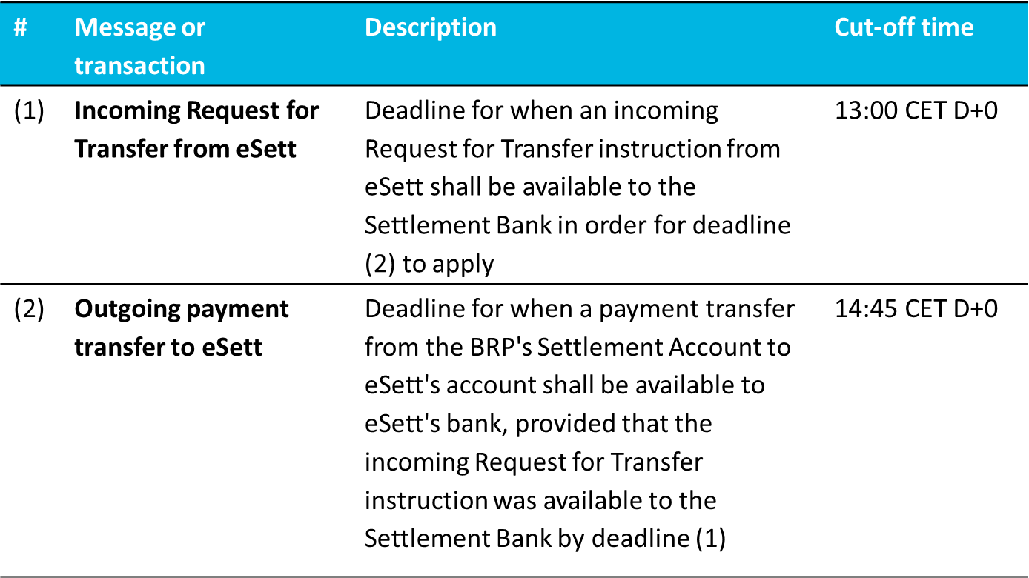
Schedule for execution of Request for Transfer

Slide 12
Daily reporting of Balances and Transactions on the Cash Accounts to eSett
For collateral monitoring and for ensuring orderly settlement of outstanding invoices, eSett needs to have up to date information about the balances and transactions on the BRPs’ Cash Accounts
The Settlement Bank shall make daily end-of-day transaction and balance reports on the BRPs’ Cash Accounts available to eSett in the SWIFT MT940 format defined by SWIFT
The MT940 reports will be retrieved from the Settlement Bank on eSett’s behalf by eSett’s bank
When needed, the Settlement Bank shall also respond to eSett’s enquiries concerning transactions and balances on a Cash Account during the day.

Slide 13
Provision of collateral
A BRP operating in Denmark is not required to post collateral to eSett. However, should the BRP operate in any other country in eSett’s model, they need to have fulfil collateral requirements.
  Minimum collateral demand in the other countries is EUR 40 000,00
  A dynamic collateral model is being used. Collaterals are calculated every weekday, and new collateral demands can be published if the demand has increased substantially
  Collateral can be posted by funds on the pledged settlement account, by On-Demand Guarantee or a combination of the two

Slide 14
Service fees
The BRP is responsible for all applicable service fees for the settlement bank services
eSett is not responsible for any fees or costs incurred by the Settlement Bank
Any pricing model can be applied to the settlement bank services, but settlement account cannot be used to cover the bank’s service fees as all the funds need to be pledged to eSett

Slide 15
Requirements on Settlement Banks
Technical requirements for settlement banks:
  ▪ A bank domiciled in Denmark, Finland, Iceland, Norway or Sweden (including a branch of such a bank, the branch operating in
  Denmark, Finland, Iceland, Norway or Sweden)
  ▪ Member of SWIFT or operating through another SWIFT member
  ▪ Ability to execute Request for Transfer instruction / MT101 with Same Day Value according to eSett's schedule
  ▪ Ability to include remittance information from incoming MT101 in outgoing payment
  ▪ Ability to report balances in MT940 format according to eSett's schedule
  ▪ Valid Settlement Bank Agreement with eSett
  ▪ Valid bilateral agreement with eSett's bank (Nordea) for execution of Request for Transfer transactions
• Rating requirements for settlement banks:
  ▪ The Settlement Bank needs to be rated by at least one of the three major rating agencies (Fitch, Moody's or Standard & Poor's)
  and the rating must be on at least the following level:
  - Standard & Poor's: long term rating “A-"
  - Moody's: long term rating "A3"
  - Fitch: long term rating “A-"
  ▪ If the Settlement Bank is rated by several agencies, at least one of the ratings must be on the aforementioned level and the
  lowest rating must be at least BBB+ (Fitch, Standard & Poor's) or Baa1 (Moody's).

Slide 16
Contract structure for governing invoicing, payments and collateral in the Nordic imbalance settlement
eSett
Imbalance Settlement Agreement
BRP
Pledged /
Non-Pledged Cash Account Agreement
On-Demand Guarantee
Banking service agreements
Settlement Bank Agreement
eSett's Bank
(Nordea)
Bilateral agreement for Request for Transfer
Settlement Bank

Slide 17
Essential terms of Settlement Bank Agreement
Governance of Pledged Cash Accounts
  Opening and terms
  Pledge in favor of eSett
  Right of disposal for eSett
  Procedure for release of excess funds
Governance of Non-Pledged Cash Accounts
  Opening and terms
  Right of disposal for eSett
Execution of Request for Transfer Transactions
Reporting of Account Balances and Transactions to eSett
Issuing of On-Demand Guarantees
Notices and other communication
Liability
Fees
Appendices:
  Operating procedures
  Requirements on Settlement Banks
  Pledged Cash Account Agreement
  Non-Pledged Cash Account Agreement

Slide 18
Essential terms of Cash Account Agreements
Pledged Cash Account Agreement
  Pledge in favour of eSett
  Right of Disposal for eSett
  Information Disclosure
  Procedure for release of excess funds
  Appendix: Settlement Bank Agreement
Non-Pledged Cash Account Agreement
  Right of Disposal for eSett
  Information Disclosure
  Appendix: Settlement Bank Agreement

Slide 19
Essential terms of On-Demand Guarantee
Currency can be DKK, EUR, NOK or SEK
Payable on first demand
Payment within 3 banking days of demand
Continuing guarantee, can be terminated by bank with 3 months’ notice
  Upon termination the guarantee remains valid for payment obligations incurred until the termination date until such payment obligations have been settled in full

Slide 20
Steps to become a settlement bank
Bank informs eSett about intention to act as Settlement Bank
  Notices to finance@esett.com or named contact persons at eSett
  Bank to appoint contact person for further communication
eSett requests and reviews information about the bank’s capability to operate in accordance with eSett’s operating procedures
eSett confirms to the bank whether the bank can be approved as a Settlement Bank in the Nordic Imbalance Settlement
Bank and eSett sign Settlement Bank Agreement
eSett performs end-to-end testing of Request for Transfer transaction and Balance Reporting together with selected BRP
eSett adds bank onto public list of approved Settlement Banks

Slide 21
Further information
eSett’s website www.esett.com
Handbook chapters 8 and 9
Materials – Settlement banks
Contacts:
Noora Candan
noora.candan@esett.com
+358 10 501 8536
Neea Hyttinen
neea.hyttinen@esett.com
+358 10 501 8530
Or
finance@esett.com

